Slide 1
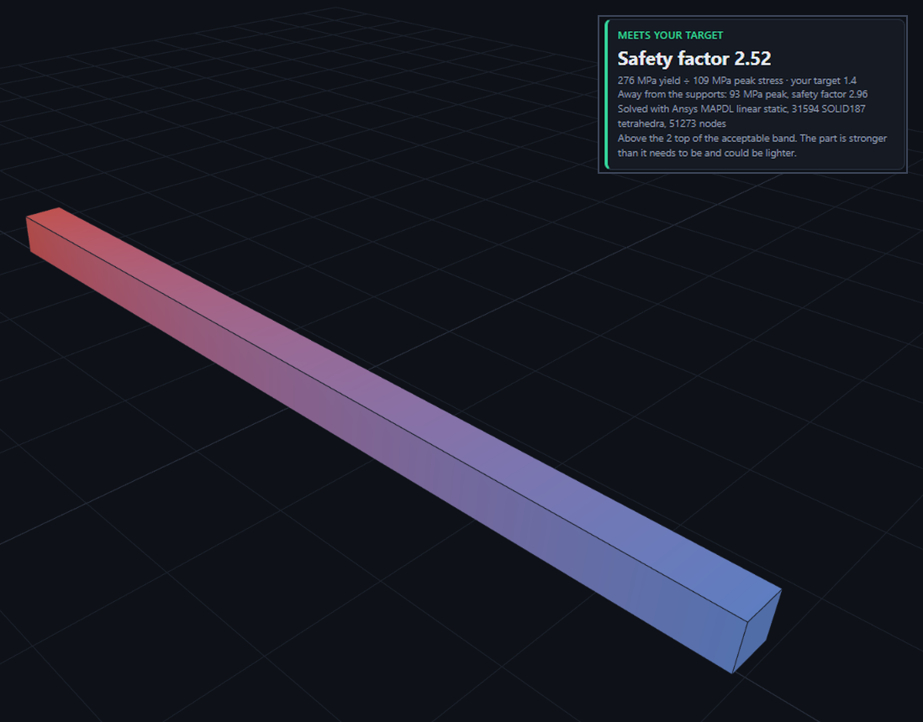
SimForge
LIFE IN SPACE · TEAM 97070 · GEAUX HACK 2026
Will this part hold on the Moon? Ask in one sentence.
Import a STEP file, name the destination, and describe the test. SimForge sets up the Ansys analysis and returns a safety factor in minutes.
Arav Gandhi · Kevin Guo · Braxton Anderson · Amr Mohieldin · Jeremy Lin
Notes:
0:00 to 0:20. Say it in one breath: "Engineers lose days setting up a stress check. With SimForge you import the part, say where it is going, and describe the test in a sentence. Ansys does the solve and you get a safety factor for the Moon, Mars or orbit." Then name the team. The picture is the real app result for the cantilever beam: peak stress 109 MPa at the support, 93 MPa and a safety factor of 2.96 away from it.

Slide 2
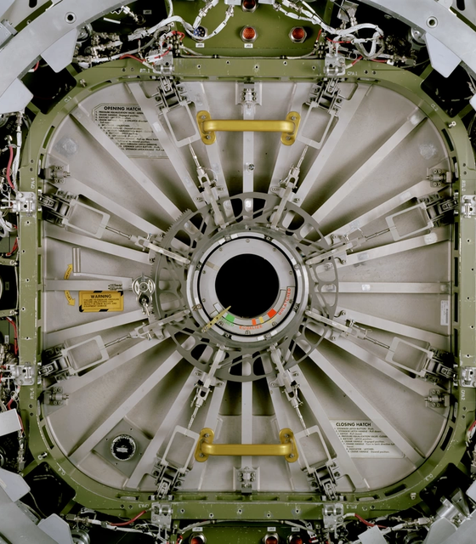
A habitat only works if its structure holds
Gravity changes
Moon 1.62 m/s², Mars 3.73 m/s². The same 500 kg rack loads its mount about 2.3 times harder on Mars.
Pressure pushes out
Every pressurized wall has cabin air on one side and almost nothing on the other.
Checks are slow
Setting up a finite element check by hand takes expertise. We turn it into a conversation.
Image: NASA, JSC2001-02112. ISS common hatch in the Space Station Systems Trainer.
Notes:
0:20 to 0:45. Gravity changes the load, pressure pushes on every wall, and setting up a check by hand takes expertise. The same 500 kg rack loads its mount about 2.3 times harder on Mars than on the Moon (3.73 divided by 1.62). The photo is an ISS hatch in NASA's ground trainer, so say "an ISS hatch in NASA's training mock-up", not "on the station".

Slide 3
Built for Life in Space
Help humans sustain life in extreme off-Earth environments
Hostile environments
Habitat metrics
Crew consequences
The Moon, Mars, Mercury, Venus, Pluto and free space, each with gravity and outside pressure from NASA fact sheets.
Cabin pressures from NASA documents: 14.7 psia ISS-type, 8.0 psia lunar habitat, 7.6 psia Mars habitat.
Each result says what a failure would mean for the people inside, such as a hatch letting cabin pressure fall.
Any other world works too: type its name and give its surface gravity and outside pressure.
Notes:
0:45 to 1:15. Tie the project to the prompt. Hostile environments: real gravity and outside pressure for six worlds plus free space, from NASA fact sheets. Habitat metrics: ISS-type, lunar and Mars cabin pressures from NASA documents. Survival: every result states what a failure means for the crew, and a hatch result compares the cabin pressure with NASA's 5.0 to 15.0 psia range for indefinite crew exposure.

Slide 4
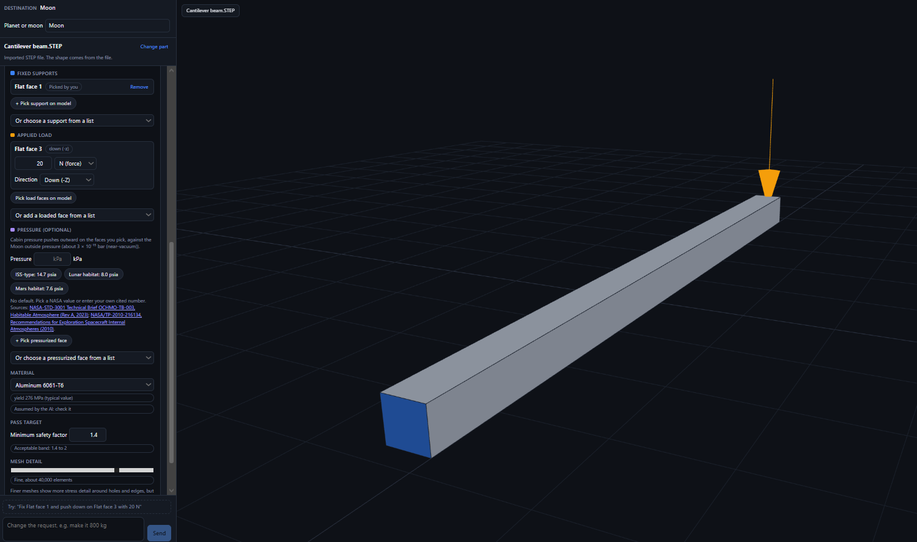
How it works
Describe
1
Import a STEP file, type a destination, and write the test in plain English.
Propose
2
Google Gemini picks the fixed faces, the load and the material, and lights them up in 3D.
Confirm
3
You check the faces on the model, change any by clicking it, and approve.
Analyze
4
Ansys cuts the part into tiny pieces and solves the stress in each one.
Notes:
1:15 to 1:40. Four steps: describe, propose, confirm, analyze. Stress the confirmation step: the screenshot shows the fixed end in blue, the load arrow in orange, and every value editable on the card before anything runs. In this shot the support was picked by clicking the model, which is why the tag reads Picked by you. Gemini only proposes. You approve.

Slide 5
What happens under the hood
Browser
Backend
Gemini
Mesh
Ansys
React and three.js draw the 3D model
→
A Python server (FastAPI) reads the STEP file
→
Proposes faces, load and material from your sentence
→
gmsh cuts the part into tiny four-sided blocks
→
Solves the stress in every block
A dial for detail
Self-repairing meshes
Backups at every step
Coarse is about 5,000 blocks and runs fast. Finest is about 65,000 and shows more detail. You choose.
Curved parts can produce a block Ansys rejects. We straighten its edges automatically so the run continues.
If Gemini is busy, a lighter model answers. If both fail, plain rules do, and the chat says so.
Ansys Student allows one session at a time. If an old session blocks it, the backend ends the stale one and restarts Ansys by itself.
Notes:
1:40 to 2:10. Walk left to right. The browser draws the model. A Python server reads the STEP file. Gemini turns your sentence into a proposal. A mesher cuts the part into tiny four-sided blocks, and Ansys solves the stress in each block. Then the three cards: a dial that trades detail for speed, automatic repair of bad blocks on curved parts, and backups so the demo keeps working if one piece fails. Keep it light. Do not read the footer.

Slide 6
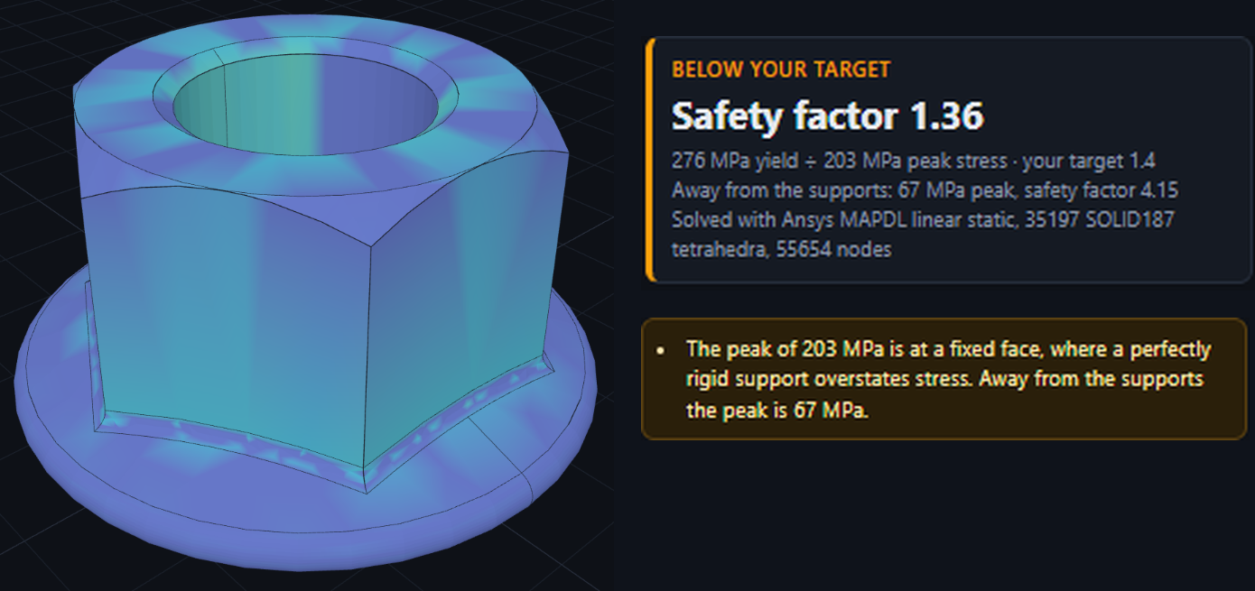
SimForge compared with SolidWorks
SimForge
SolidWorks
THE MANUAL ROUTE, SIX STEPS
1
Create a static study
4
Add loads, look up gravity
2
Assign the material
5
Set the mesh
3
Add fixtures
6
Run, then plot stress
Describe the test in plain English
Gravity and pressure filled in per destination
Verdict plus safety factor in one screen
Loads, fixtures and materials set up by hand
Look up each world's gravity and pressure
Safety factor shown, you judge pass or fail
Notes:
2:10 to 2:30. SolidWorks is a great tool, but you set up every load, fixture and material by hand, and you look up each world's gravity yourself. SimForge does the setup from a sentence and tells you pass, below target or fail. The right side lists the usual steps of a SolidWorks static study, so the audience can count the work.

Slide 7
Safety factor decides the verdict
Yield strength divided by peak stress
Below 1
1 to 1.4
1.4 to 2
Above 2
Fail
Below target
Acceptable
Heavier than needed
The part yields.
Holds, with too little margin.
Our target band.
Passes with margin to spare.
The 1.4 to 2 band is our own requirement. For comparison, NASA-STD-5001B asks for 1.4 on ultimate strength and 1.25 on yield for protoflight metallic hardware. We apply 1.4 to yield, which is stricter.
Notes:
2:30 to 2:50. Safety factor is yield strength divided by peak von Mises stress. Below 1 the part yields. From 1 to 1.4 it holds but with too little margin. 1.4 to 2 is our acceptable band. Above 2 it passes but is heavier than it needs to be. The band is our own requirement, not a building code.

Slide 8
Demo
Import the beam STEP file
Type the destination: the Moon
Describe the test in plain English
Confirm the highlighted faces
Run Ansys, read the safety factor
LIVE
Notes:
2:50 to 5:40. Run the demo live. Before you start, restart the backend and check /api/health. Import Cantilever beam.STEP, type the Moon, click the Try suggestion under the chat box, check the highlighted faces, and run it at Fine mesh detail. Read out the safety factor and the stress away from the support (about 93 MPa). If there is time, import hex flange nut_am.STEP and run its Try suggestion: a bolt pulls on the threaded bore, so the force is shared by two faces. If Ansys stalls, play the backup recording and say it is a recording.

Slide 9
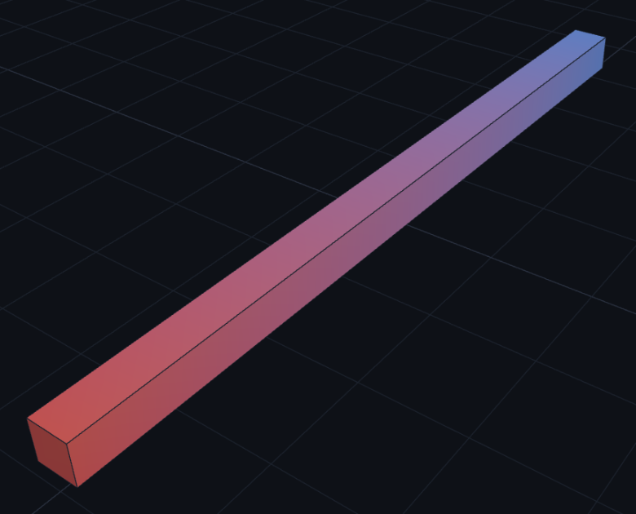
We checked the answer against a hand calculation
Tip deflection, under 1% apart
1.85 mm
1.86 mm
Ansys
Beam theory
Peak stress, about 3% apart
93 MPa
96 MPa
Ansys
Beam theory
6061-T6 aluminum beam, 100 x 5 x 5 mm, 20 N at the free end, 31,594 mesh blocks. Stress is read away from the fixed end, where a rigid support overstates it (109 MPa at the edge).
Notes:
5:40 to 6:20. This is how we know the number is right. The beam is a textbook case: stress is 6FL over bh squared, deflection is FL cubed over 3EI. Ansys got 1.85 mm against 1.86 mm by hand, and 93 MPa against 96 MPa. The stress is read away from the fixed end because a perfectly rigid support overstates it. The edge reading of 109 MPa is a known artifact of a perfectly rigid support, and the app shows both numbers.

Slide 10
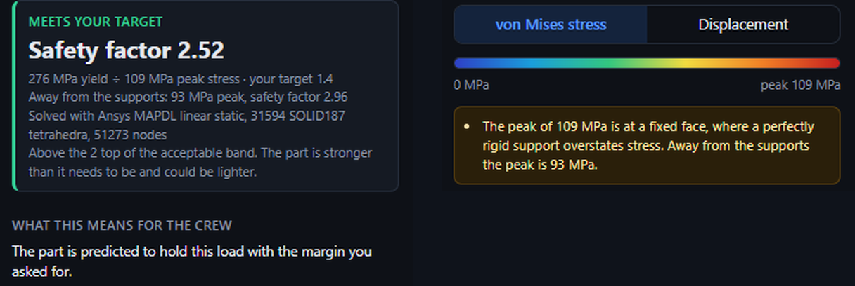
The AI never decides the verdict
The AI picks
Ansys solves
Sources supply
Faces, a load direction and a starting material (flagged "check it"), plus the numbers you wrote. Gemini 3.8 Flash, with 3.5 Flash-Lite as backup.
The stress and the safety factor come from the solver.
Gravity and outside pressure from NASA. Material values from datasheets.
Sources: NASA-STD-5001B · NASA-STD-3001 Technical Brief · NASA/TP-2010-216134 · NASA planetary fact sheets
Notes:
6:20 to 6:50. The AI proposes surfaces, a load direction and a starting material, which the card marks as assumed by the AI so the user checks it, and it reads the numbers the user wrote. It never sets the gravity, the pressure, the material values or the safety factor. Those come from NASA files, datasheets and the solver. Point at the result card: the numbers come from Ansys, and the crew text comes from NASA values. Gemini only picked the faces and read the numbers you wrote. If Gemini 3.8 is busy, Gemini 3.5 Flash-Lite answers.

Slide 11
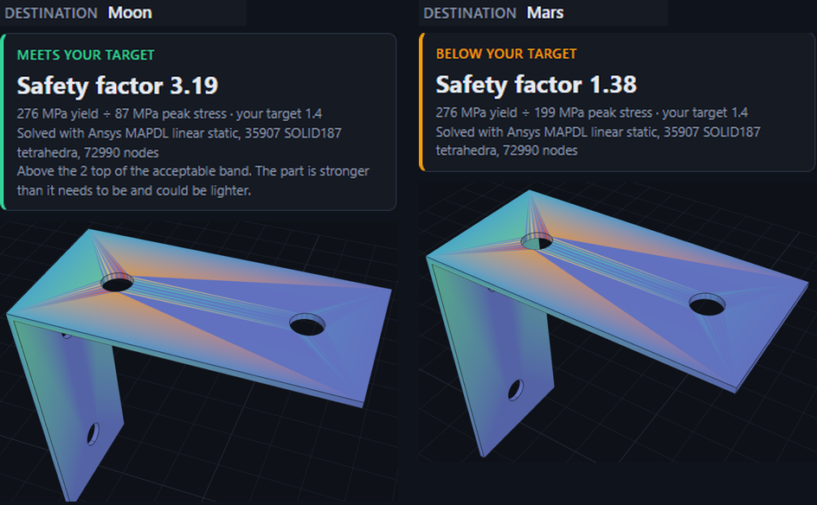
Who it helps
Student and hobby teams
Check a design before building it, without learning simulation setup.
Small aerospace startups
Get a first stress answer in minutes, before booking an analyst.
Engineers new to simulation
Review the setup the copilot proposes instead of building it from scratch.
Same L bracket, same 30 kg load, same mesh. The Moon gives a safety factor of 3.19. On Mars the stress is 2.3 times higher, so the same part drops to 1.38, below our target.
Notes:
6:50 to 7:30. Three groups who need a quick structural check but not a simulation specialist: student teams, small aerospace startups and engineers new to simulation. Then point at the picture: the same L bracket and the same 30 kg load. Peak stress is 87 MPa on the Moon and 199 MPa on Mars, about 2.3 times higher, matching the ratio of the two gravities. The Moon passes with a safety factor of 3.19, and Mars falls to 1.38, below target.

Slide 12
Thank you
SIMFORGE · TEAM 97070
The team
Arav Gandhi, frontend, UX and backend
Braxton Anderson, frontend and backend
Questions?
Amr Mohieldin and Jeremy Lin, backend assistants
Kevin Guo, pitch, presentation and team management
Will this part hold on the Moon? Now you can ask in one sentence.
Built with TypeScript, React, three.js, Vite, Python, FastAPI, gmsh, Ansys MAPDL and the Gemini API
Notes:
7:30 to 8:00. Thank the judges. Leave this slide up for questions. Likely questions: what the AI does versus Ansys, how we know the result is right (the beam check), and what is not covered yet (linear static analysis only, no contact, bolts, thermal or buckling).

